Slide 1
Algorithms #3
A supplemental lesson for AP CSP

Slide 2
Algorithms
AP CSP Big Idea #3
All programming languages use similar programming structures and commands.
Students should have a basic understanding of how these building blocks are combined to form algorithms and abstractions.
This big idea focuses on determining the efficiency of algorithms, as well as writing and implementing algorithms in a program.

Slide 3
Algorithms
The algorithms you have evaluated so far have used sequencing and selection.
From CollegeBoard Create PT Rubric:
Sequencing: The application of each step of an algorithm in the order in which the code statements are given.
Selection (conditional statement): A selection / conditional statement affects the sequential flow of control by executing different statements based on a condition being true or false. The use of if-statements and try/exception statements are examples of selection / conditional statements.

Slide 4
Algorithms
Algorithms also use iteration.
From CollegeBoard Create PT Rubric:
Iteration: Iteration is a repetitive portion of an algorithm. Iteration repeats until a given condition is met or for a specified number of times.
A while loop and a for loop are examples of iteration.
Another example is a repeat loop.
You will see robot code problems with repeat loops on the AP Exam.

Slide 5
Review: Robot Commands
MOVE_FORWARD()
Robot moves one square forward in the direction it is facing.
ROTATE_LEFT()
Robot rotates 90 degrees counterclockwise (robot’s left) in the square it is in.
ROTATE_RIGHT()
Robot rotates 90 degrees clockwise (robot’s right) in the square it is in.
If any of the commands have a number in parenthesis (an argument), the action is performed that many times. Otherwise, the action is performed once.

Slide 6
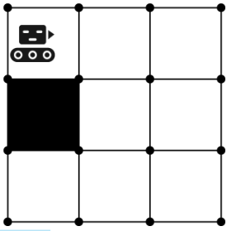
Review: Robot Commands
CAN_MOVE(direction)
Using robot sensors, the robot checks to see if there is an open square in the direction specified.
The statement evaluates to True or False.
The robot does not move, but answers the question: Can I move [left, right, or forward]?
CAN_MOVE(forward) → True
CAN_MOVE(left) → False
CAN_MOVE(right) → False

Slide 7
Robot Selection Structures:
IF (condition)
{ robot commands
}
The robot commands will execute only when the condition is True. When the condition is False, the robot commands are skipped.
IF (condition)
{ robot commands
}
ELSE
{ robot commands
}
The first commands will execute only when the condition is True. When the condition is False, the second set of commands is executed.

Slide 8
Robot Iteration Structures:
REPEAT n TIMES
{ robot commands
}
Like a for loop
Robot commands are repeated exactly n times.
REPEAT FOREVER
{ robot commands
}
Like a while true loop
Robot commands are repeated over and over, indefinitely.
REPEAT UNTIL (condition)
{ robot commands
}
Similar to a while loop
Robot commands execute only when the condition is false.
When the condition is true, the commands are no longer executed.

Slide 9
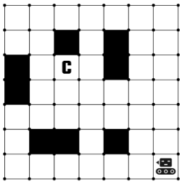
Robot Code:
Try this sample problem: Does the code get the robot to delivery chute (C)?
PROGRAM #1:
REPEAT 2 TIMES:
{ MOVE_FORWARD()
MOVE_FORWARD()
MOVE_FORWARD()
ROTATE_RIGHT()
}
REPEAT 2 TIMES:
{ ROTATE_LEFT()
MOVE_FORWARD()
}
Notes:
Answer: It does get the robot to delivery chute C.

Slide 10
Robot Code:
Try this sample problem: Does the code get the robot to delivery chute (C)?
PROGRAM #2:
REPEAT 2 TIMES:
{ ROTATE_RIGHT()
MOVE_FORWARD()
MOVE_FORWARD()
MOVE_FORWARD()
ROTATE_RIGHT()
ROTATE_RIGHT()
}
REPEAT 2 TIMES:
{ ROTATE_LEFT()
MOVE_FORWARD()
}
Notes:
Answer: It does get the robot to delivery chute C.

Slide 11

Your turn!
Complete the problems on your activity guide.

